Slide 1
CAPSTONE PROJECT
SAKILA DVD RENTAL STORE
Abir Ghosh

Slide 2
TOPICS
Project Overview
Information about Dataset tables
Data cleaning and MECE-Breakdown
Solving Power Bi and EDA Questions
Dashboard Analysis
Conclusion

Slide 3
Project Overview
The Sakila DVD Rental Store data analysis project aims to uncover customer preferences, rental trends, and revenue drivers through thorough data exploration and advanced analytics techniques. By leveraging the dataset, insights will be derived to optimize operations, enhance customer satisfaction, and inform strategic decisions for business growth. Tools such as MySQL, Excel, and visualization software like Power BI will be utilized to conduct the analysis and present findings effectively.

Slide 4
Information about Dataset tables
Actors
Address
Category
City
Country
Customer
Film
Film actor
Film category
Film text
Inventory
Language
Payment
Rental
Staff
Store

Slide 5
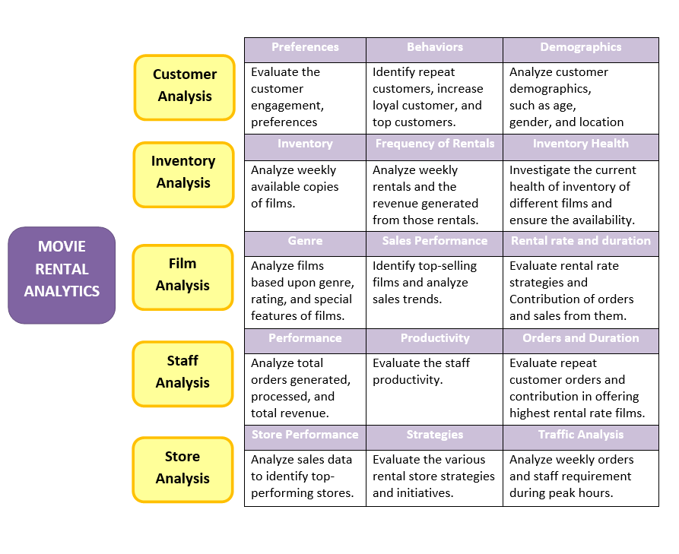
Data cleaning and MECE-Breakdown
The Table contains many null value almost in each attributes ,Replaced each text data with N/A, numeric data with ‘-1’.Beside that I also created some columns which help me in visualization. After all the transformation I have created a MECE-breakdown for better understanding of dataset.

Slide 6
Solving EDA and Power BI Questions
EDA questions and answers

Slide 7
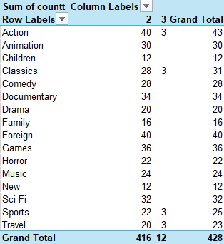
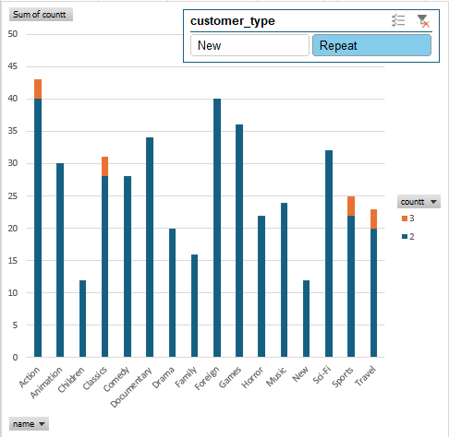
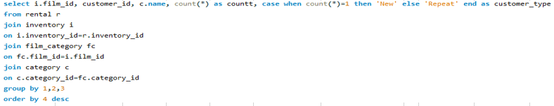
What are the purchasing patterns of new customers versus repeat customers?

Slide 8
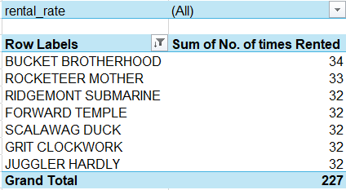
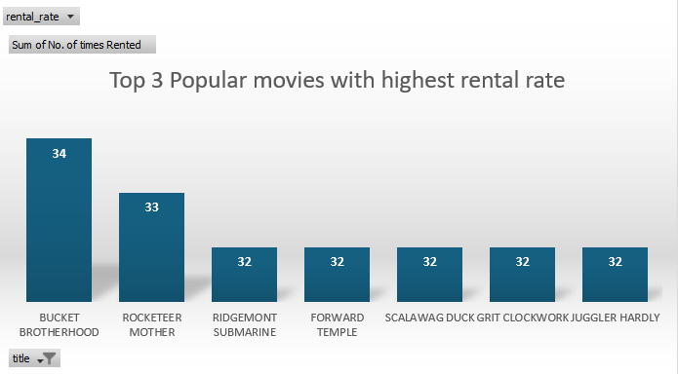
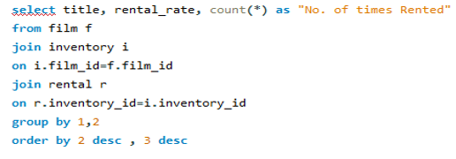
Which films have the highest rental rates and are most in demand?

Slide 9
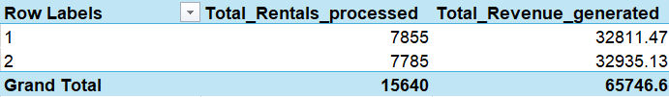
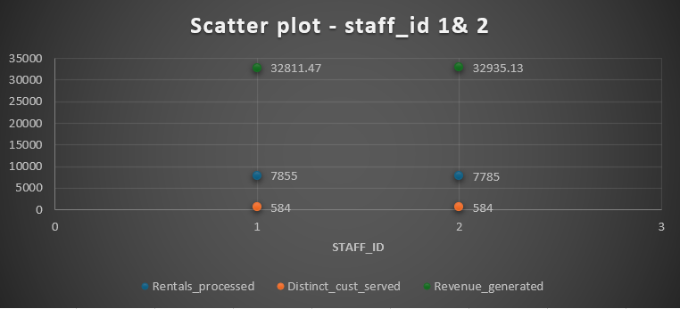
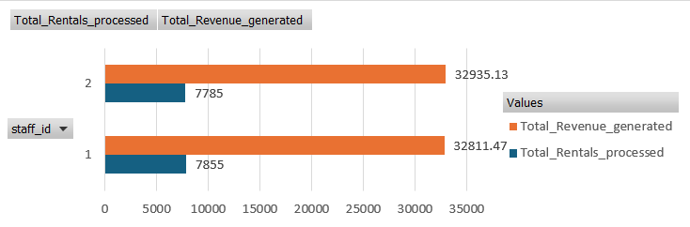
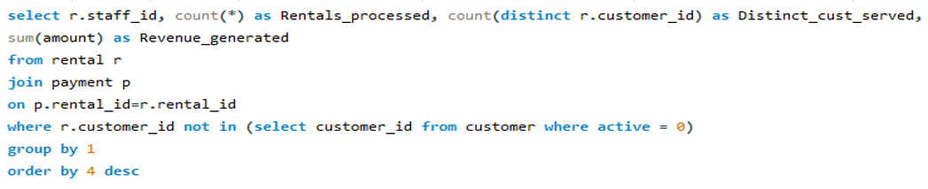
Are there correlations between staff performance and customer satisfaction?

Slide 10
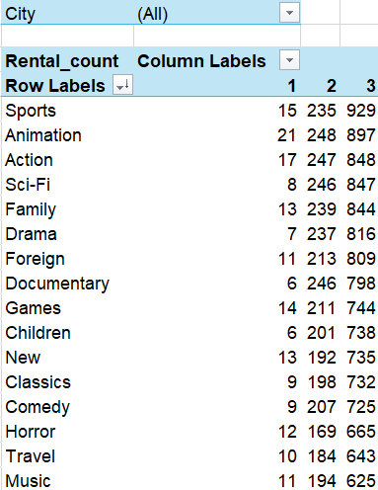
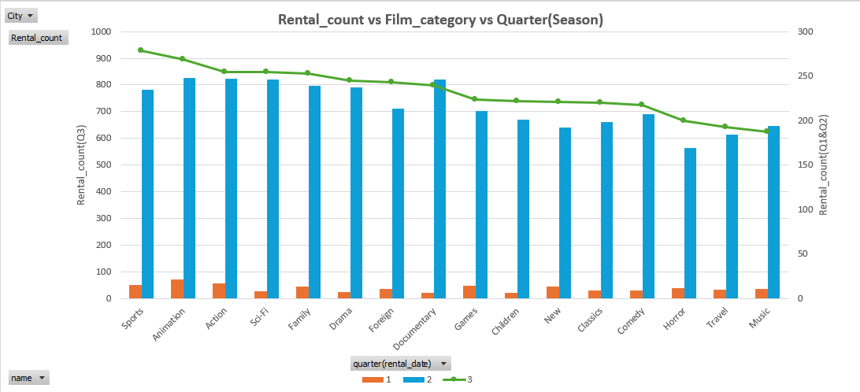
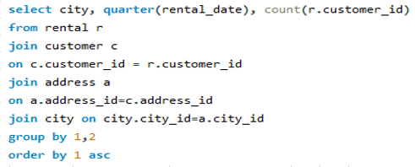
Are there seasonal trends in customer behavior across different locations?

Slide 11
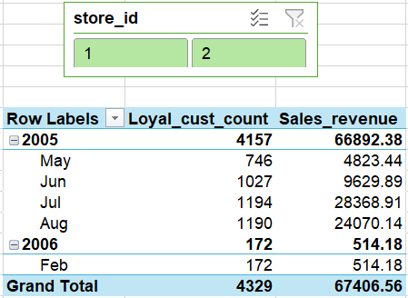
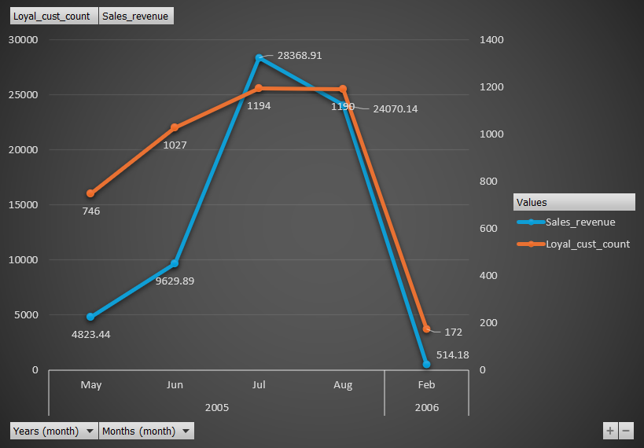
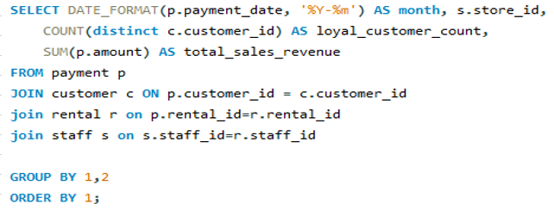
How does customer loyalty impact sales revenue over time?

Slide 12
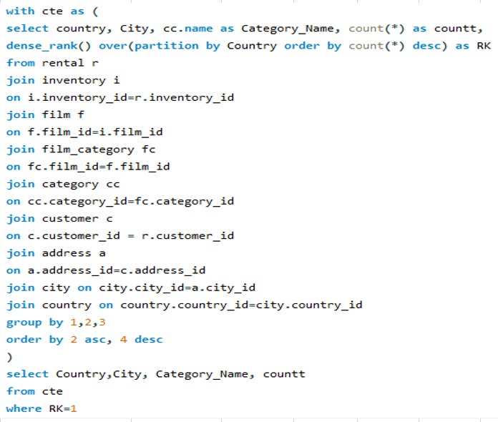
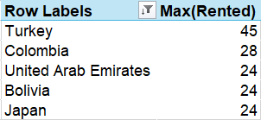
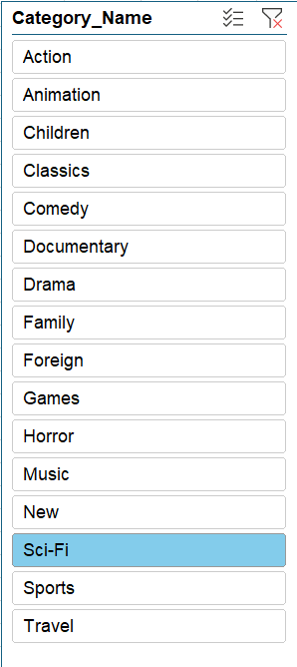
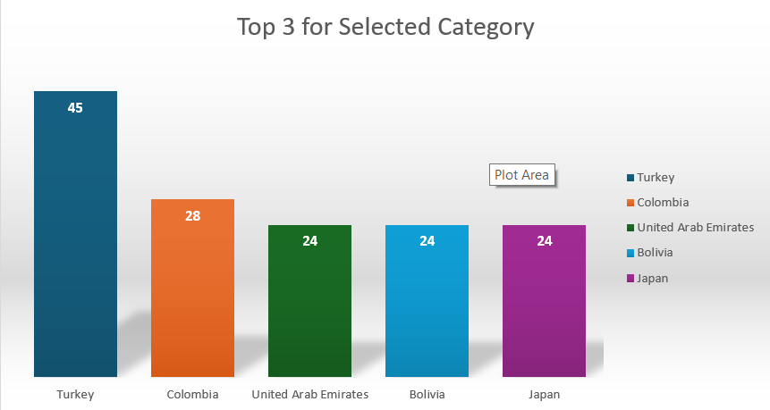
Are certain film categories more popular in specific locations?

Slide 13
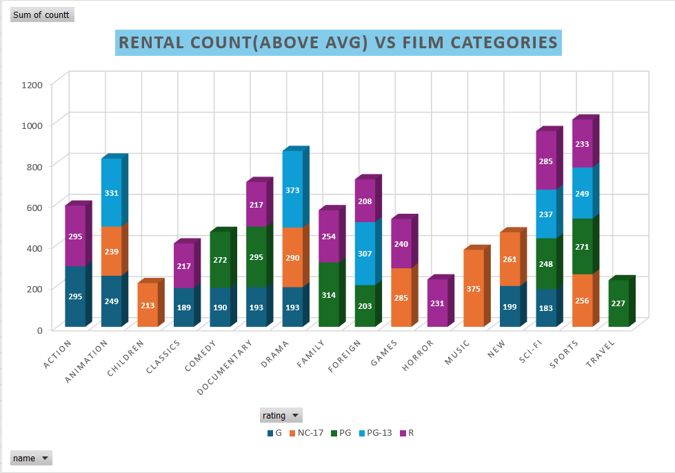
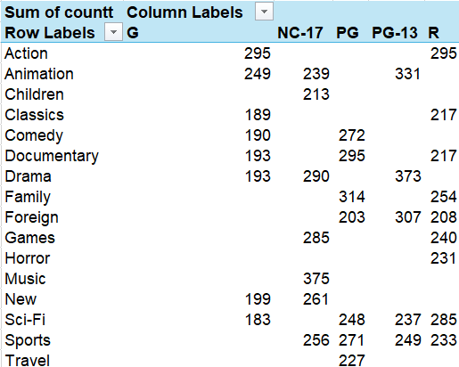
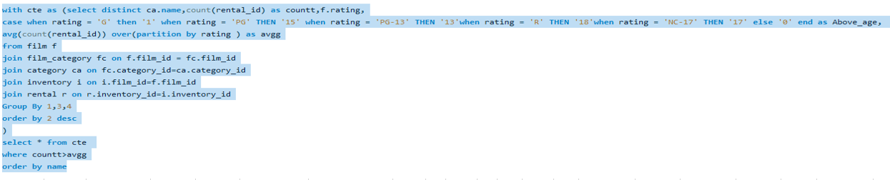
Do specific film categories attract different age groups of customers?

Slide 14
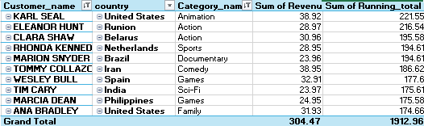
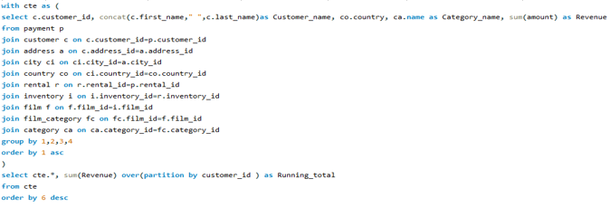
What are the demographics and preferences of the highest-spending customers?

Slide 15
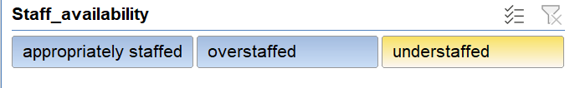
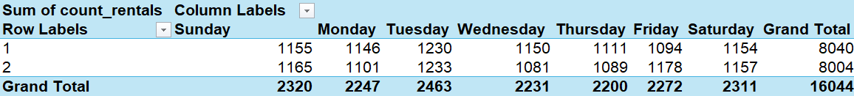
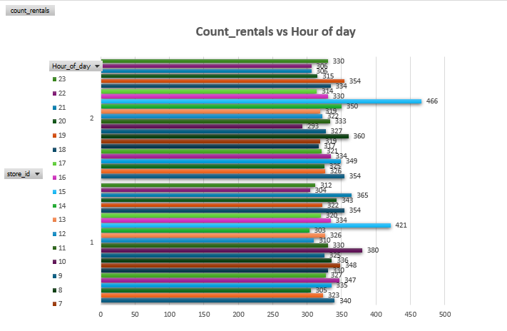
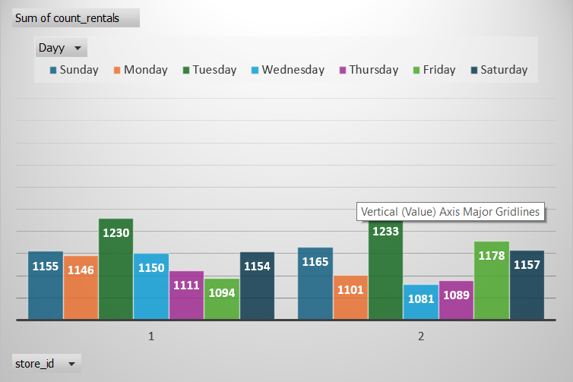
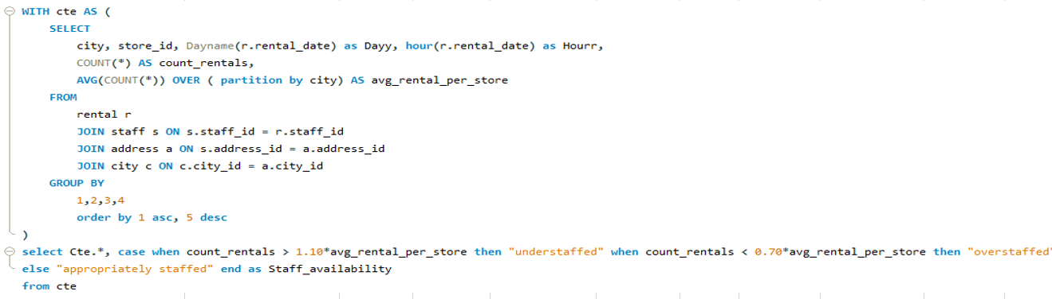
What are the busiest hours or days for each store location, and how does it impact staffing requirements?

Slide 16
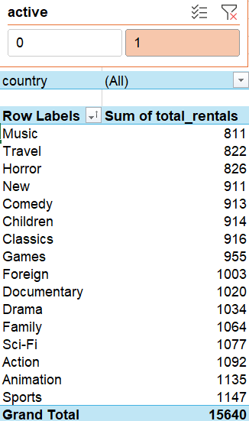
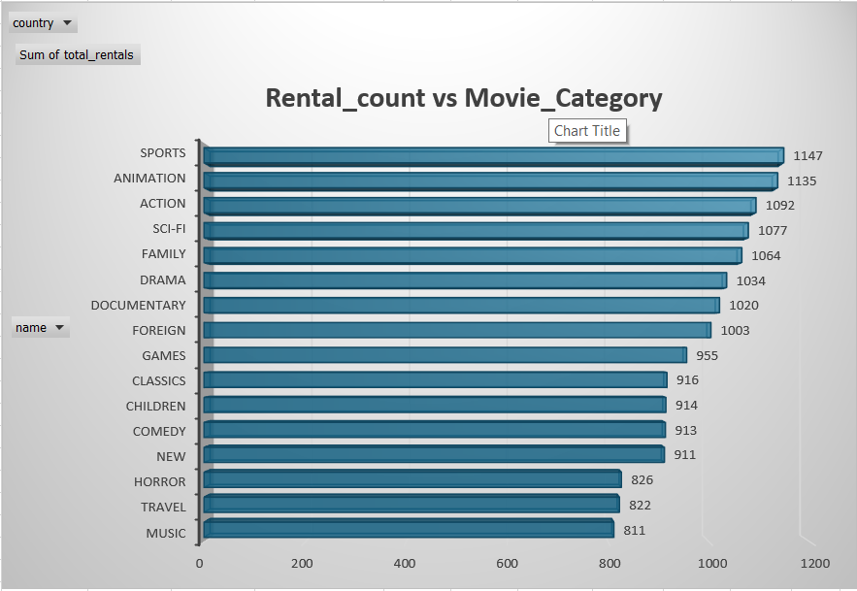
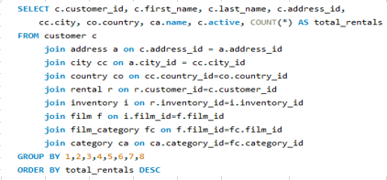
What are the cultural or demographic factors that influence customer preferences in different locations?

Slide 17
Solving EDA and Power BI Questions
Power BI questions and answers

Slide 18
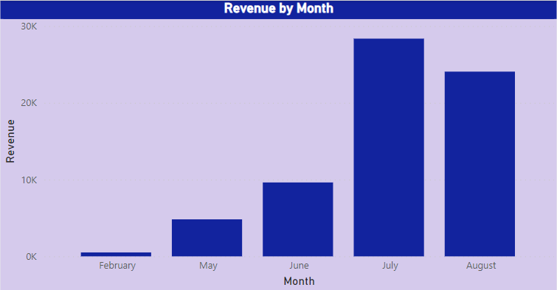
How does the sales revenue vary by month?
The Clustered Column Chart gives us a complete idea to understand the earning revenue structure by month.

Slide 19
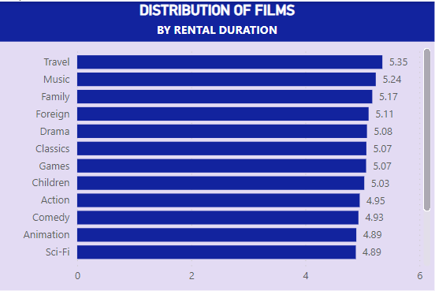
What is the distribution of films by rental duration?
The Stacked Bar Chart gives us a complete idea to understand the average rental duration by film category.

Slide 20
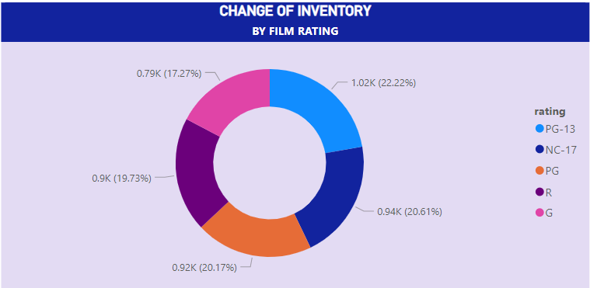
How does the inventory vary by film rating?
The slices of this donut chart gives us a complete idea to understand partitions and percentage of inventory dived by rating of films.

Slide 21
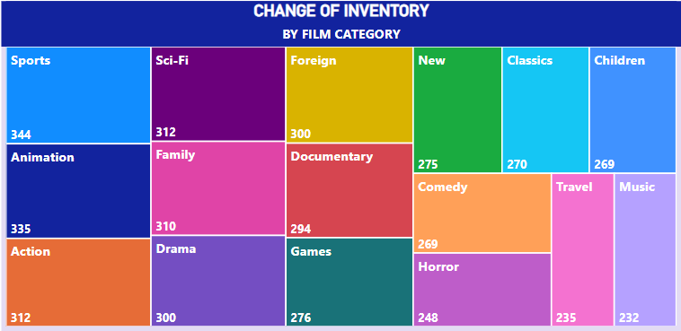
What is the breakdown of film categories in the inventory?
Each part of the Tree map gives us a complete idea to understand the count of inventory for each film category.

Slide 22
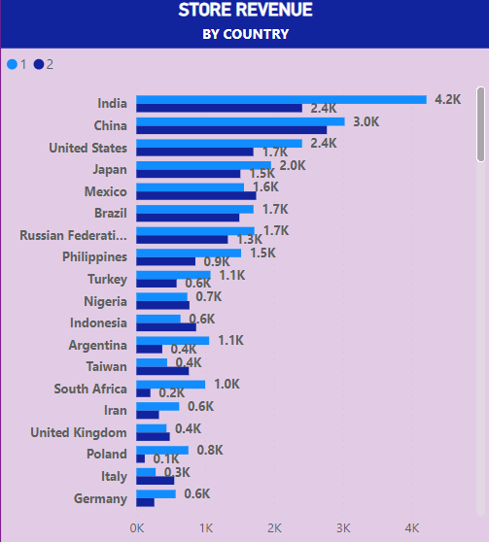
How does the store performance vary by location?
The Clustered Bar Chart gives us a complete idea to understand the earning revenue structure based on country for each store.

Slide 23
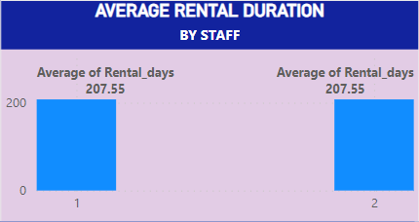
What is the average rental duration by staff member?
The Clustered Column Chart gives us a complete idea that the average rental days of each staff are very same.

Slide 24
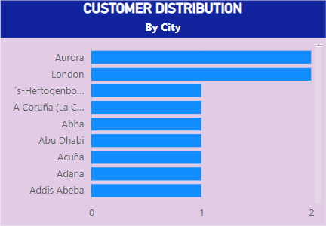
What is the distribution of customers across different cities?
The Stacked Bar Chart gives us a complete idea of the number of customers by cites.

Slide 25
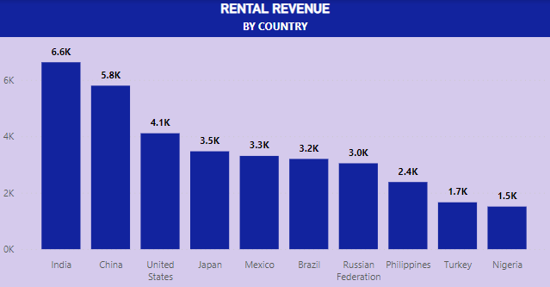
How does the rental revenue vary by country?
The Clustered Column Chart gives us a complete idea to understand the earning revenue structure by top 10 countries.

Slide 26
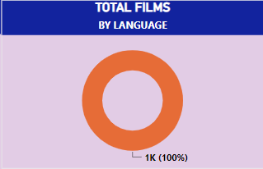
What is the distribution of films by language?
The complete Donut Chart gives us an idea that all the films are rented have a unique language.

Slide 27
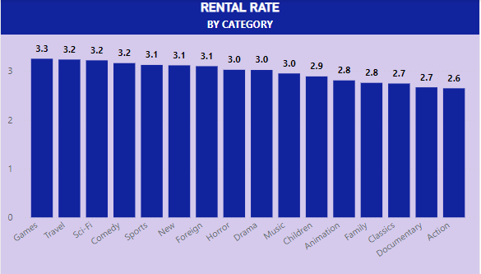
Which film categories have the highest rental rates?
The Clustered Column Chart gives us the knowledge of rental rate by film category.

Slide 28
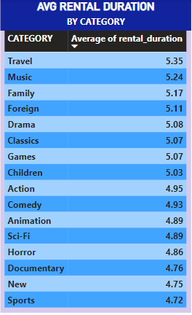
How does the average rental duration vary by film category?
The Table gives us a complete idea to understand the average rental duration by film category.

Slide 29
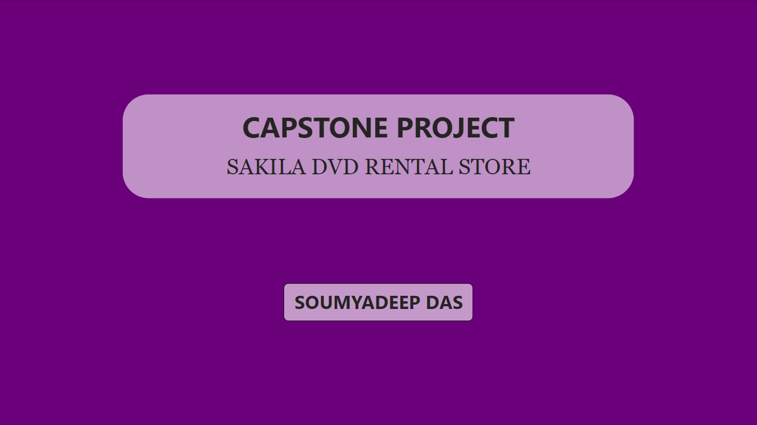
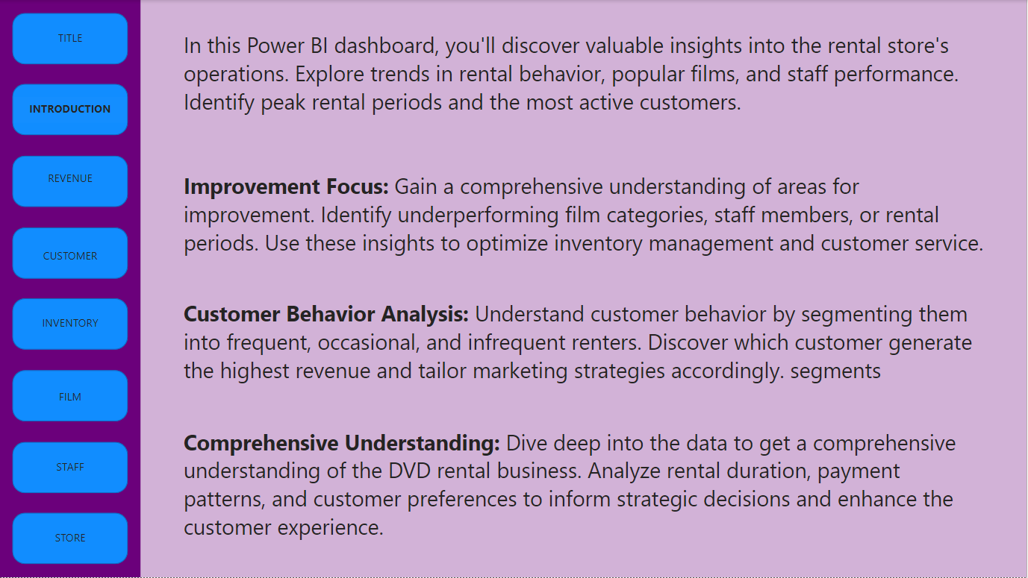
Dashboard Analysis
TITLE PAGE
INTRODUCTION PAGE

Slide 30
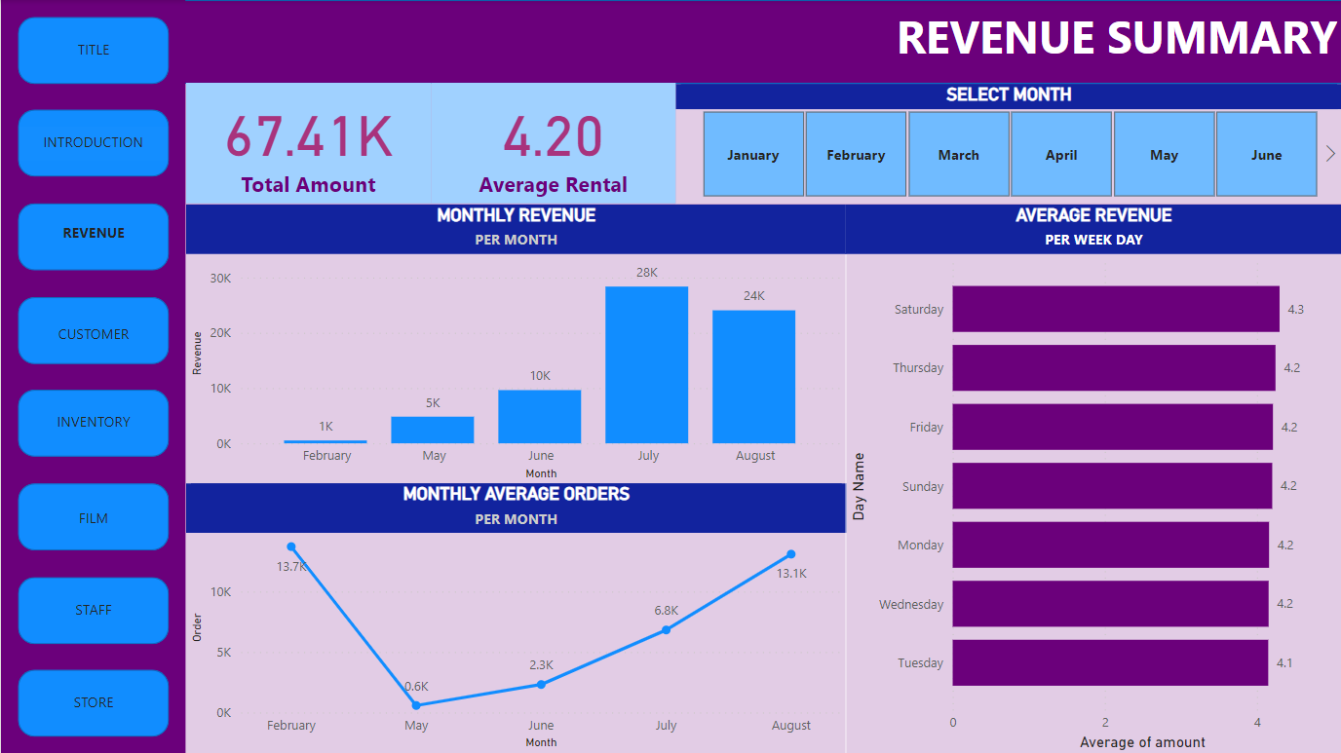
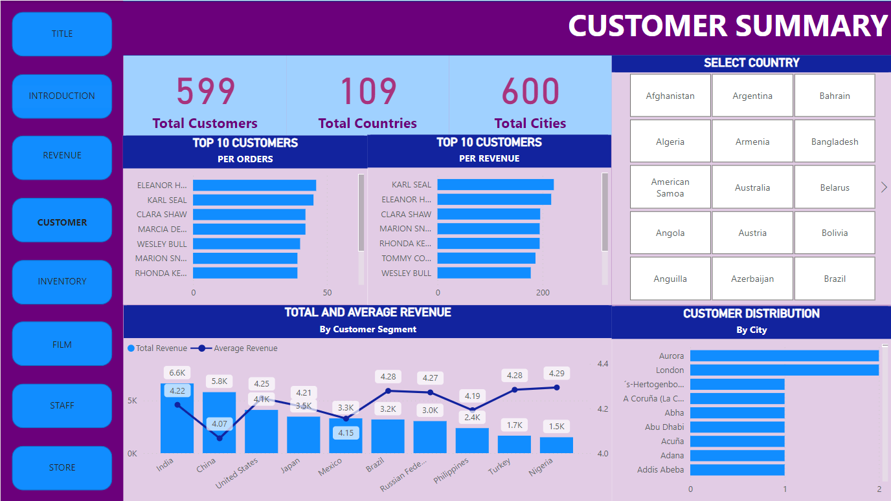
Dashboard Analysis
REVENUE SUMMARY
CUSTOMER SUMMARY

Slide 31
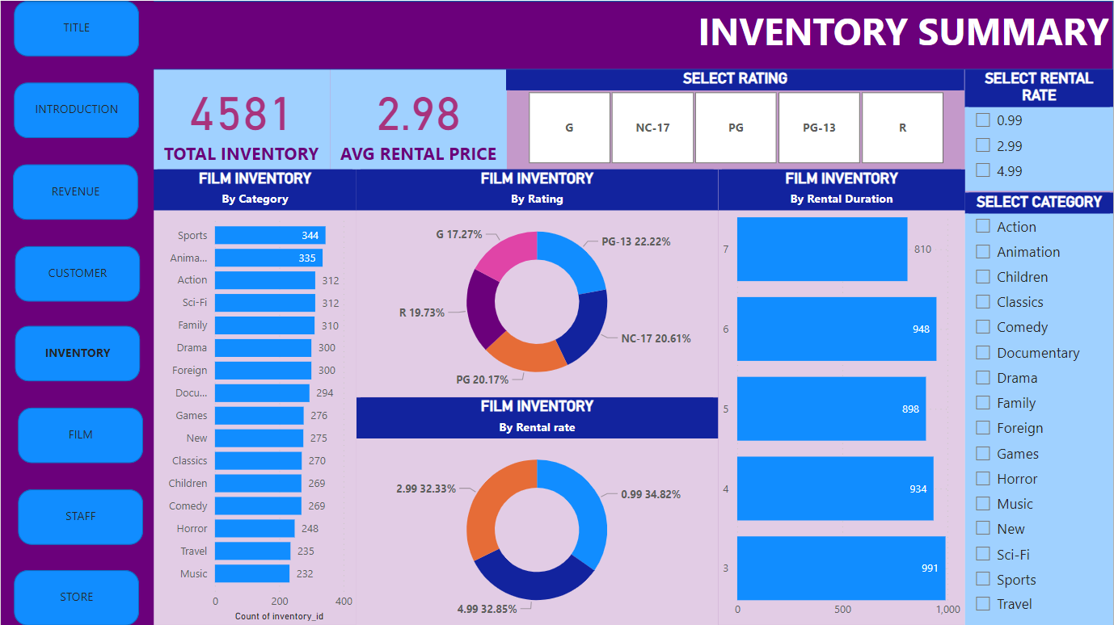

Dashboard Analysis
INVENTORY SUMMARY
FILM SUMMARY

Slide 32


Dashboard Analysis
STAFF SUMMARY
STORE SUMMARY

Slide 33
Conclusion
The Sakila DVD rental store project reveals customer preferences and rental trends, guiding inventory management and marketing strategies. Insights into revenue and operational efficiency suggest avenues for growth and cost reduction. Implementing a recommendation system could enhance the customer experience, while digital solutions streamline operations. Overall, leveraging data-driven strategies positions Sakila to thrive in the competitive entertainment market

